Slide 1



Rebuilding
the
Domain Name System
Mohamed Samy
Principal Security Researcher
@Texnomic
Texnomic © 2019

Slide 2








Who Am I
Forward-Engineer By Day
Reverse-Engineer By Night
Data Scientist By Coincidence
Anti-Money Laundry Enforcer
Offensive Security Warrior
Texnomic © 2019

Slide 3
Agenda
It’s Always DNS
DNS: The “Accurate” Definition
DNS: A 1980s Protocol in a 2020 Cyberwar
DNS: Protocol Deep-Dive
DNS Attacks in Wildlife
Standardized Cross-Platform “Lack” of Security
Understanding DNS Over TLS & HTTP/S
Modernizing Codebase
Retaking Control: Sink-holing, Monitoring & Way More!
Making Your-Own DNS Root Server!
Texnomic © 2019

Slide 4
Agenda
It’s Always DNS
DNS: The “Accurate” Definition
DNS: A 1980s Protocol in a 2020 Cyberwar
DNS: Protocol Deep-Dive
DNS Attacks in Wildlife
Standardized Cross-Platform “Lack” of Security
Understanding DNS Over TLS & HTTP/S
Modernizing Codebase
Retaking Control: Sink-holing, Monitoring & Way More!
Making Your-Own DNS Root Server!
Texnomic © 2019

Slide 5





It’s Always DNS
Major Incidence
2012
2014
2016
2019
Texnomic © 2019

Slide 6
Agenda
It’s Always DNS
DNS: The “Accurate” Definition
DNS: A 1980s Protocol in a 2020 Cyberwar
DNS: Protocol Deep-Dive
DNS Attacks in Wildlife
Standardized Cross-Platform “Lack” of Security
Understanding DNS Over TLS & HTTP/S
Modernizing Codebase
Retaking Control: Sink-holing, Monitoring & Way More!
Making Your-Own DNS Root Server!
Texnomic © 2019

Slide 7
Agenda
It’s Always DNS
DNS: The “Accurate” Definition
DNS: A 1980s Protocol in a 2020 Cyberwar
DNS: Protocol Deep-Dive
DNS Attacks in Wildlife
Standardized Cross-Platform “Lack” of Security
Understanding DNS Over TLS & HTTP/S
Modernizing Codebase
Retaking Control: Sink-holing, Monitoring & Way More!
Making Your-Own DNS Root Server!
Texnomic © 2019

Slide 8




DNS: The “Accurate” Definition
Textbook Style
Hierarchical Distributed Schema-less Database
Texnomic © 2019

Slide 9
DNS: The “Accurate” Definition
Textbook Style
Hierarchical Distributed Schema-less Database
Texnomic © 2019

Slide 10
DNS: The “Accurate” Definition
Hierarchical:
1. Fully Qualified Domain Name (FQDN)
WWW
EXAMPLE
COM
Top-Level Domain
Second-Level Domain
Sub-Domain
Texnomic © 2019

Slide 11
DNS: The “Accurate” Definition
Textbook Style
Hierarchical Distributed Schema-less Database
Texnomic © 2019

Slide 12
DNS: The “Accurate” Definition
Textbook Style
Hierarchical Distributed Schema-less Database
Texnomic © 2019

Slide 13
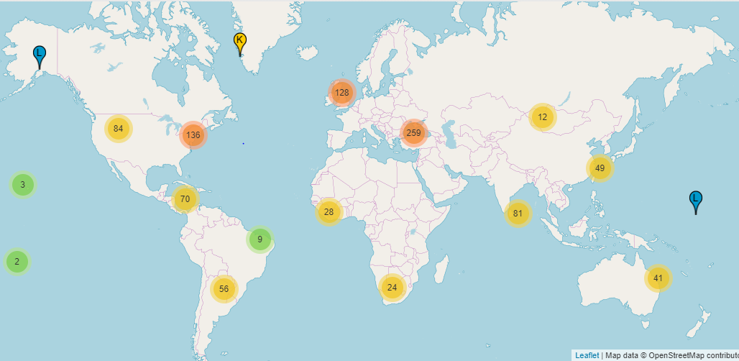
DNS: The “Accurate” Definition
Distributed:
1. Root Servers
13 Root Servers
12 Independent Organizations
Texnomic © 2019

Slide 14
DNS: The “Accurate” Definition
Textbook Style
Hierarchical Distributed Schema-less Database
Texnomic © 2019

Slide 15
DNS: The “Accurate” Definition
Textbook Style
Hierarchical Distributed Schema-less Database
Texnomic © 2019

Slide 16
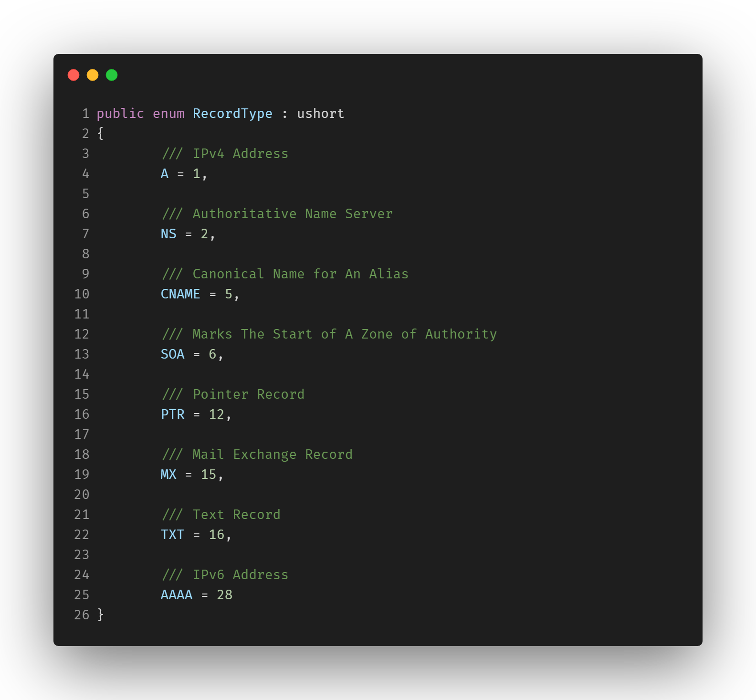
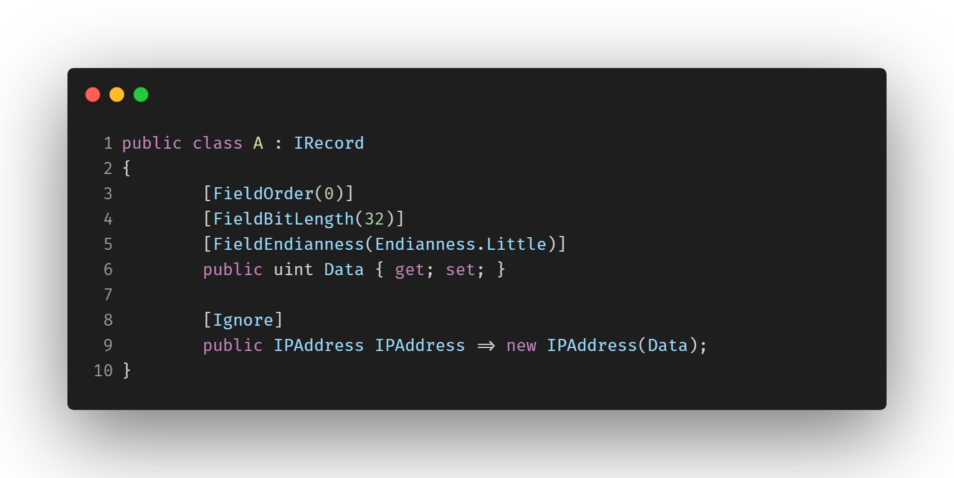
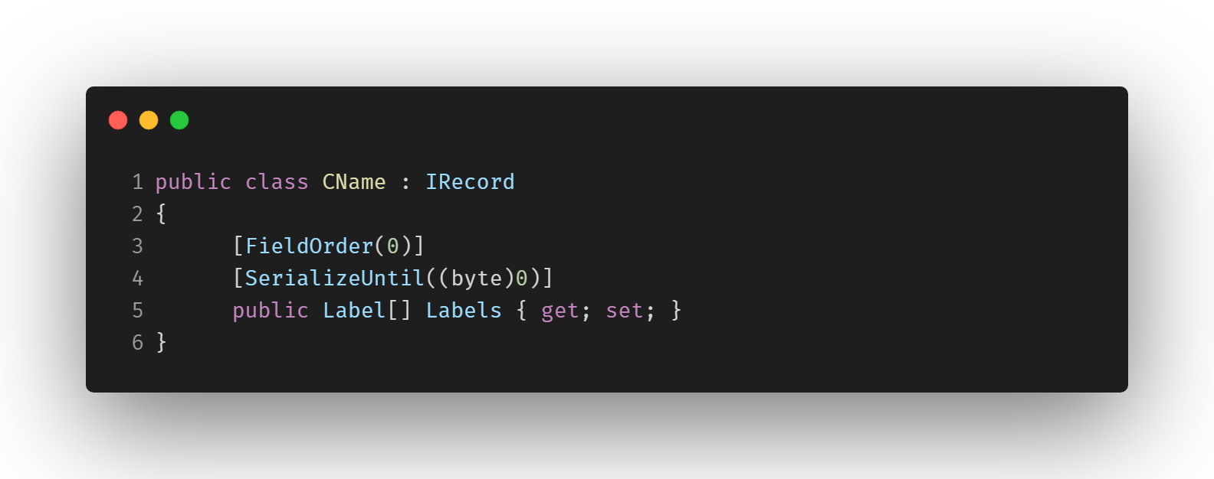
DNS: The “Accurate” Definition
Schema-less:
1. Format
Texnomic © 2019

Slide 17
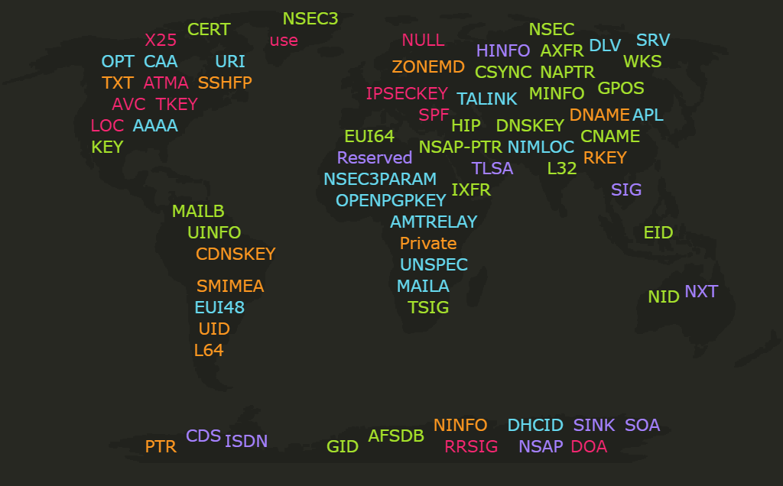
DNS: The “Accurate” Definition
Schema-less:
2. Recourse Records
90+
Texnomic © 2019

Slide 18
DNS: The “Accurate” Definition
Textbook Style
Hierarchical Distributed Schema-less Database
Texnomic © 2019

Slide 19
DNS: The “Accurate” Definition
Textbook Style
Hierarchical Distributed Schema-less Database
Texnomic © 2019

Slide 20
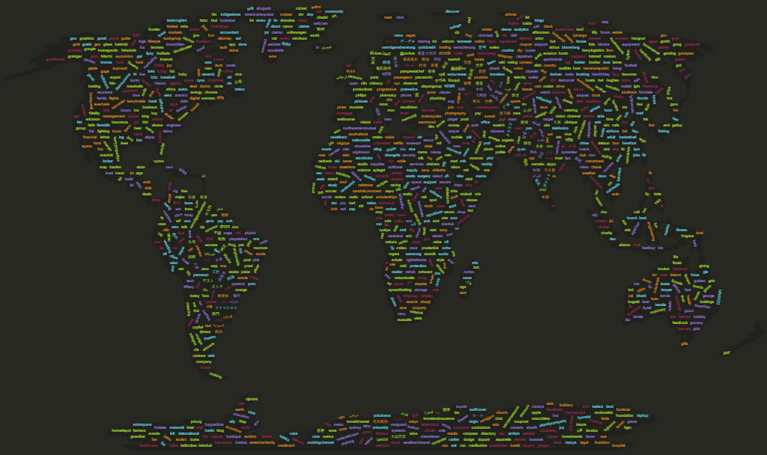
DNS: The “Accurate” Definition
Database: TLDs
1,500+
Texnomic © 2019

Slide 21
DNS: The “Accurate” Definition
Database: Domains
356,290,000+
Texnomic © 2019

Slide 22
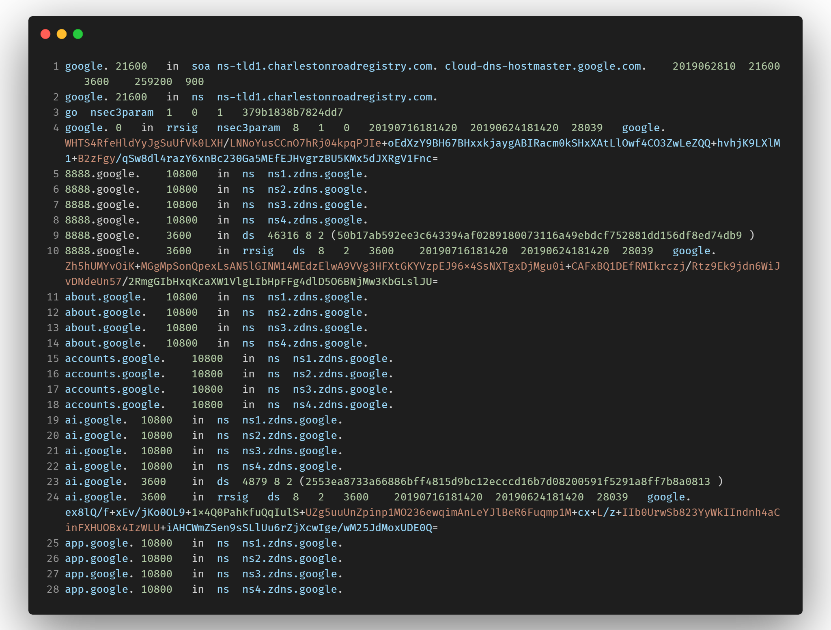
DNS: The “Accurate” Definition
Database: Zone Files
Texnomic © 2019

Slide 23
Agenda
It’s Always DNS
DNS: The “Accurate” Definition
DNS: A 1980s Protocol in a 2020 Cyberwar
DNS: Protocol Deep-Dive
DNS Attacks in Wildlife
Standardized Cross-Platform “Lack” of Security
Understanding DNS Over TLS & HTTP/S
Modernizing Codebase
Retaking Control: Sink-holing, Monitoring & Way More!
Making Your-Own DNS Root Server!
Texnomic © 2019

Slide 24
Agenda
It’s Always DNS
DNS: The “Accurate” Definition
DNS: A 1980s Protocol in a 2020 Cyberwar
DNS: Protocol Deep-Dive
DNS Attacks in Wildlife
Standardized Cross-Platform “Lack” of Security
Understanding DNS Over TLS & HTTP/S
Modernizing Codebase
Retaking Control: Sink-holing, Monitoring & Way More!
Making Your-Own DNS Root Server!
Texnomic © 2019

Slide 25
DNS: A 1980s Protocol in a 2020 Cyberwar
Request for Comments (RFCs) from Internet Engineering Task Force (IETF)
Date | Topic | Number
Nov 1983 | The Domain Names Plan and Schedule | 881
Feb 1984 | Domain Name System Implementation Schedule | 897
Oct 1984 | Domain Name System Implementation Schedule - Revised | 921
Oct 1985 | DOD Internet Host Table Specification | 952
Nov 1987 | Domain Administrators Guide | 1032
Nov 1987 | Domain Administrators Operations Guide | 1033
Nov 1987 | Domain Names - Concepts and Facilities | 1034
Nov 1987 | Domain Names - Implementation and Specification | 1035
Apr 1989 | DNS Encoding of Network Names and Other Types | 1101
Oct 1989 | Requirements for Internet Hosts -- Application and Support | 1123
Oct 1990 | New DNS RR Definitions | 1183
Dec 1992 | An Experiment in DNS Based IP Routing | 1383
Jan 1993 | Correspondence between the IAB and DISA on the use of DNS throughout the Internet | 1401
May 1993 | Using the Domain Name System To Store Arbitrary String Attributes | 1464
Oct 1993 | A Security Problem and Proposed Correction With Widely Deployed DNS Software | 1535
Oct 1993 | Common DNS Implementation Errors and Suggested Fixes | 1536
Mar 1994 | Domain Name System Structure and Delegation | 1591
May 1994 | DNS Server MIB Extensions | 1611
May 1994 | DNS Resolver MIB Extensions | 1612
Oct 1994 | DNS NSAP Resource Records | 1706
Nov 1994 | DNS Encoding of Geographical Location | 1712
Nov 1994 | Tools for DNS debugging | 1713
Apr 1995 | DNS Support for Load Balancing | 1794
Jan 1996 | A Means for Expressing Location Information in the Domain Name System | 1876
Feb 1996 | Common DNS Operational and Configuration Errors | 1912
Aug 1996 | Serial Number Arithmetic | 1982
Aug 1996 | Incremental Zone Transfer in DNS | 1995
Aug 1996 | A Mechanism for Prompt Notification of Zone Changes (DNS NOTIFY) | 1996
Feb 1997 | HMAC: Keyed-Hashing for Message Authentication | 2104
Apr 1997 | Dynamic Updates in the Domain Name System (DNS UPDATE) | 2136
Jan 1998 | Using the Internet DNS to Distribute MIXER Conformant Global Address Mapping (MCGAM) | 2163
Jun 1997 | Resolution of Uniform Resource Identifiers using the Domain Name System | 2168
Jul 1997 | Clarifications to the DNS Specification | 2181
Jul 1997 | Selection and Operation of Secondary DNS Servers | 2182
Oct 1997 | Use of DNS Aliases for Network Services | 2219
Nov 1997 | Key Exchange Delegation Record for the DNS | 2230
Mar 1998 | Negative Caching of DNS Queries (DNS NCACHE) | 2308
Mar 1998 | Classless IN-ADDR.ARPA delegation | 2317
Mar 1999 | DSA KEYs and SIGs in the Domain Name System (DNS) | 2536
Mar 1999 | Storage of Diffie-Hellman Keys in the Domain Name System (DNS) | 2539
Mar 1999 | Detached Domain Name System (DNS) Information | 2540
Jun 1999 | Reserved Top Level DNS Names | 2606
Aug 1999 | Extension Mechanisms for DNS (EDNS0) | 2671
Aug 1999 | Non-Terminal DNS Name Redirection | 2672
Aug 1999 | Binary Labels in the Domain Name System | 2673
Feb 2000 | A DNS RR for specifying the location of services (DNS SRV) | 2782
May 2000 | A Tangled Web: Issues of I18N, Domain Names, and the Other Internet Protocols | 2825
May 2000 | IAB Technical Comment on the Unique DNS Root | 2826
May 2000 | Secret Key Transaction Authentication for DNS (TSIG) | 2845
Jun 2000 | Root Name Server Operational Requirements | 2870
Jul 2000 | DNS Extensions to Support IPv6 Address Aggregation and Renumbering | 2874
Sep 2000 | E.164 number and DNS | 2916
Sep 2000 | Secret Key Establishment for DNS (TKEY RR) | 2930
Sep 2000 | DNS Request and Transaction Signatures ( SIG(0)s ) | 2931
Nov 2000 | Secure Domain Name System (DNS) Dynamic Update | 3007
Feb 2001 | Reflections on the DNS, RFC 1591, and Categories of Domains | 3071
May 2001 | RSA/SHA-1 SIGs and RSA KEYs in the Domain Name System (DNS) | 3110
Jun 2001 | A DNS RR Type for Lists of Address Prefixes (APL RR) | 3123
Jun 2001 | Notes from the State-Of-The-Technology: DNSSEC | 3130
Dec 2001 | Indicating Resolver Support of DNSSEC | 3225
Dec 2001 | DNSSEC and IPv6 A6 aware server/resolver message size requirements | 3226
Apr 2002 | Distributing Authoritative Name Servers via Shared Unicast Addresses | 3258
Aug 2002 | Representing Internet Protocol version 6 (IPv6) Addresses in the Domain Name System (DNS) | 3363
Aug 2002 | Tradeoffs in Domain Name System (DNS) Support for Internet Protocol version 6 (IPv6) | 3364
Oct 2002 | Dynamic Delegation Discovery System (DDDS) Part One: The Comprehensive DDDS | 3401
Oct 2002 | Dynamic Delegation Discovery System (DDDS) Part Two: The Algorithm | 3402
Oct 2002 | Dynamic Delegation Discovery System (DDDS) Part Three: The Domain Name System (DNS) Database | 3403
Oct 2002 | Dynamic Delegation Discovery System (DDDS) Part Four: The Uniform Resource Identifiers (URI) Resolution Application | 3404
Texnomic © 2019

Slide 26
DNS: A 1980s Protocol in a 2020 Cyberwar
Request for Comments (RFCs) from Internet Engineering Task Force (IETF)
Oct 2002 | Dynamic Delegation Discovery System (DDDS) Part Five: URI.ARPA Assignment Procedures | 3405
Nov 2002 | Obsoleting IQUERY | 3425
Feb 2003 | Role of the Domain Name System (DNS) | 3467
Mar 2003 | Internationalizing Domain Names in Applications (IDNA) | 3490
Mar 2003 | Nameprep: A Stringprep Profile for Internationalized Domain Names (IDN) | 3491
Mar 2003 | Punycode: A Bootstring encoding of Unicode for Internationalized Domain Names in Applications (IDNA) | 3492
Oct 2003 | DNS Extensions to Support IP Version 6 | 3596
Sep 2003 | Handling of Unknown DNS Resource Record (RR) Types | 3597
Oct 2003 | Generic Security Service Algorithm for Secret Key Transaction Authentication for DNS (GSS-TSIG) | 3645
Dec 2003 | DNS Configuration options for Dynamic Host Configuration Protocol for IPv6 (DHCPv6) | 3646
Jan 2004 | Delegation of E.F.F.3.IP6.ARPA | 3681
Apr 2004 | Joint Engineering Team (JET) Guidelines for Internationalized Domain Names (IDN) Registration and Administration for Chinese, Japanese, and Korean | 3743
Apr 2004 | The E.164 to Uniform Resource Identifiers (URI) Dynamic Delegation Discovery System (DDDS) Application (ENUM) | 3761
Apr 2004 | Telephone Number Mapping (ENUM) Service Registration for H.323 | 3762
Apr 2004 | enumservice registration for Session Initiation Protocol (SIP) Addresses-of-Record | 3764
Aug 2004 | Threat Analysis of the Domain Name System (DNS) | 3833
Sep 2004 | DNS IPv6 Transport Operational Guidelines | 3901
Jan 2005 | Domain-Based Application Service Location Using SRV RRs and the Dynamic Delegation Discovery Service (DDDS) | 3958
Feb 2005 | A Method for Storing IPsec Keying Material in DNS | 4025
Apr 2005 | Domain Name System Media Types | 4027
Mar 2005 | DNS Security Introduction and Requirements | 4033
Mar 2005 | Resource Records for the DNS Security Extensions | 4034
Mar 2005 | Protocol Modifications for the DNS Security Extensions | 4035
May 2005 | Common Misbehavior Against DNS Queries for IPv6 Addresses | 4074
Sep 2005 | A Suggested Scheme for DNS Resolution of Networks and Gateways | 4183
Oct 2005 | National and Local Characters for DNS Top Level Domain (TLD) Names | 4185
Jan 2006 | Using DNS to Securely Publish Secure Shell (SSH) Key Fingerprints | 4255
Nov 2005 | Domain Name System (DNS) Security Extensions Mapping for the Extensible Provisioning Protocol (EPP) | 4310
Feb 2006 | IPv6 Host Configuration of DNS Server Information Approaches | 4339
Jan 2006 | Domain Name System (DNS) Case Insensitivity Clarification | 4343
Feb 2006 | What's in a Name: False Assumptions about DNS Names | 4367
Mar 2006 | Storing Certificates in the Domain Name System (DNS) | 4398
Feb 2006 | The DNSSEC Lookaside Validation (DLV) DNS Resource Record | 4431
Apr 2006 | Minimally Covering NSEC Records and DNSSEC On-line Signing | 4470
Sep 2006 | Derivation of DNS Name Predecessor and Successor | 4471
Apr 2006 | Operational Considerations and Issues with IPv6 DNS | 4472
May 2006 | Domain Name System Uniform Resource Identifiers | 4501
May 2006 | Use of SHA-256 in DNSSEC Delegation Signer (DS) Resource Records (RRs) | 4509
Jul 2006 | The Role of Wildcards in the Domain Name System | 4592
Aug 2006 | HMAC SHA (Hashed Message Authentication Code, Secure Hash Algorithm) TSIG Algorithm Identifiers | 4635
Sep 2006 | DNSSEC Operational Practices | 4641
Sep 2006 | Review and Recommendations for Internationalized Domain Names (IDNs) | 4690
Oct 2006 | Observed DNS Resolution Misbehavior | 4697
Oct 2006 | A DNS Resource Record (RR) for Encoding Dynamic Host Configuration Protocol (DHCP) Information (DHCID RR) | 4701
Apr 2007 | Domain-Based Application Service Location Using URIs and the Dynamic Delegation Discovery Service (DDDS) | 4848
Jun 2007 | Requirements for a Mechanism Identifying a Name Server Instance | 4892
Jul 2007 | DNS Security (DNSSEC) Experiments | 4955
Jul 2007 | DNS Security (DNSSEC) Opt-In | 4956
Aug 2007 | Requirements Related to DNS Security (DNSSEC) Trust Anchor Rollover | 4986
Aug 2007 | DNS Name Server Identifier (NSID) Option | 5001
Sep 2007 | IPv6 Router Advertisement Option for DNS Configuration | 5006
Sep 2007 | Automated Updates of DNS Security (DNSSEC) Trust Anchors | 5011
Nov 2007 | DNSSEC Lookaside Validation (DLV) | 5074
Mar 2008 | DNS Security (DNSSEC) Hashed Authenticated Denial of Existence | 5155
Mar 2008 | 6to4 Reverse DNS Delegation Specification | 5158
Oct 2008 | Preventing Use of Recursive Nameservers in Reflector Attacks | 5358
Jan 2009 | Measures for Making DNS More Resilient against Forged Answers | 5452
Apr 2009 | Design Choices When Expanding the DNS | 5507
Aug 2009 | DNS Proxy Implementation Guidelines | 5625
Oct 2009 | Use of SHA-2 Algorithms with RSA in DNSKEY and RRSIG Resource Records for DNSSEC | 5702
Feb 2010 | DNS Blacklists and Whitelists | 5782
May 2010 | Nameservers for IPv4 and IPv6 Reverse Zones | 5855
Apr 2010 | DNS SRV Resource Records for AFS | 5864
Jul 2010 | Use of GOST Signature Algorithms in DNSKEY and RRSIG Resource Records for DNSSEC | 5933
Jun 2010 | DNS Zone Transfer Protocol (AXFR) | 5936
Aug 2010 | DNS Transport over TCP - Implementation Requirements | 5966
Nov 2010 | Cryptographic Algorithm Identifier Allocation for DNSSEC | 6014
Nov 2010 | IPv6 Router Advertisement Options for DNS Configuration | 6106
Mar 2011 | Domain Name System (DNS) IANA Considerations | 6195
Texnomic © 2019

Slide 27
DNS: A 1980s Protocol in a 2020 Cyberwar
Request for Comments (RFCs) from Internet Engineering Task Force (IETF)
137+
Nov 1987 – RFC 1035: Domain Names - Implementation and Specification
Texnomic © 2019

Slide 28
Agenda
It’s Always DNS
DNS: The “Accurate” Definition
DNS: A 1980s Protocol in a 2020 Cyberwar
DNS: Protocol Deep-Dive
DNS Attacks in Wildlife
Standardized Cross-Platform “Lack” of Security
Understanding DNS Over TLS & HTTP/S
Modernizing Codebase
Retaking Control: Sink-holing, Monitoring & Way More!
Making Your-Own DNS Root Server!
Texnomic © 2019

Slide 29
Agenda
It’s Always DNS
DNS: The “Accurate” Definition
DNS: A 1980s Protocol in a 2020 Cyberwar
DNS: Protocol Deep-Dive
DNS Attacks in Wildlife
Standardized Cross-Platform “Lack” of Security
Understanding DNS Over TLS & HTTP/S
Modernizing Codebase
Retaking Control: Sink-holing, Monitoring & Way More!
Making Your-Own DNS Root Server!
Texnomic © 2019

Slide 30



DNS: Protocol Deep-Dive
TCP vs UDP
vs
User
Datagram
Protocol
Transmission
Control
Protocol
Agent Of Order
Agent Of Chaos
Texnomic © 2019

Slide 31

DNS: Protocol Deep-Dive
Traffic
.com
Root
example.com
www.example.com
example.com
Client
Cache
Registrar
Nameserver(s)
www.example.com
Authorative
Texnomic © 2019

Slide 32
DNS: Protocol Deep-Dive
Binary Wire Format
Packet
00000000 00101110 10011001 10000010 10000001 10000000 00000000 00000001 00000000 00000001 00000000 00000000 00000000 00000000 00001000 01100110 01100001 01100011 01100101 01100010 01101111 01101111 01101011 00000011 01100011 01101111 01101101 00000000 00000000 00000001 00000000 00000001 11000000 00001100 00000000 00000001 00000000 00000001 00000000 00000000 00000001 00011110 00000000 00000100 10110011 00111100 11000000 00100100
Texnomic © 2019

Slide 33
DNS: Protocol Deep-Dive
Binary Wire Format
Message Length
00000000 00101110
Message ID
10011001 10000010
Flags
10000001 10000000
Questions Count
00000000 00000001
Authority Count
00000000 00000000
Answers Count
00000000 00000001
Additional Count
00000000 00000000
Question Label
01100110 01100001
01100011 01100101
01100010 01101111
01101111 01101011
Record Class
00000000 00000001
Time To Live
00000000 00000000
00000000 00010111
Record Length
00000000 00000100
Record Data
10110011 00111100
11000000 00100100
Question Type
00000000 00000001
Record Type
00000000 00000001
Record Label
11000000 00001100
Question Class
00000000 00000001
Texnomic © 2019

Slide 34
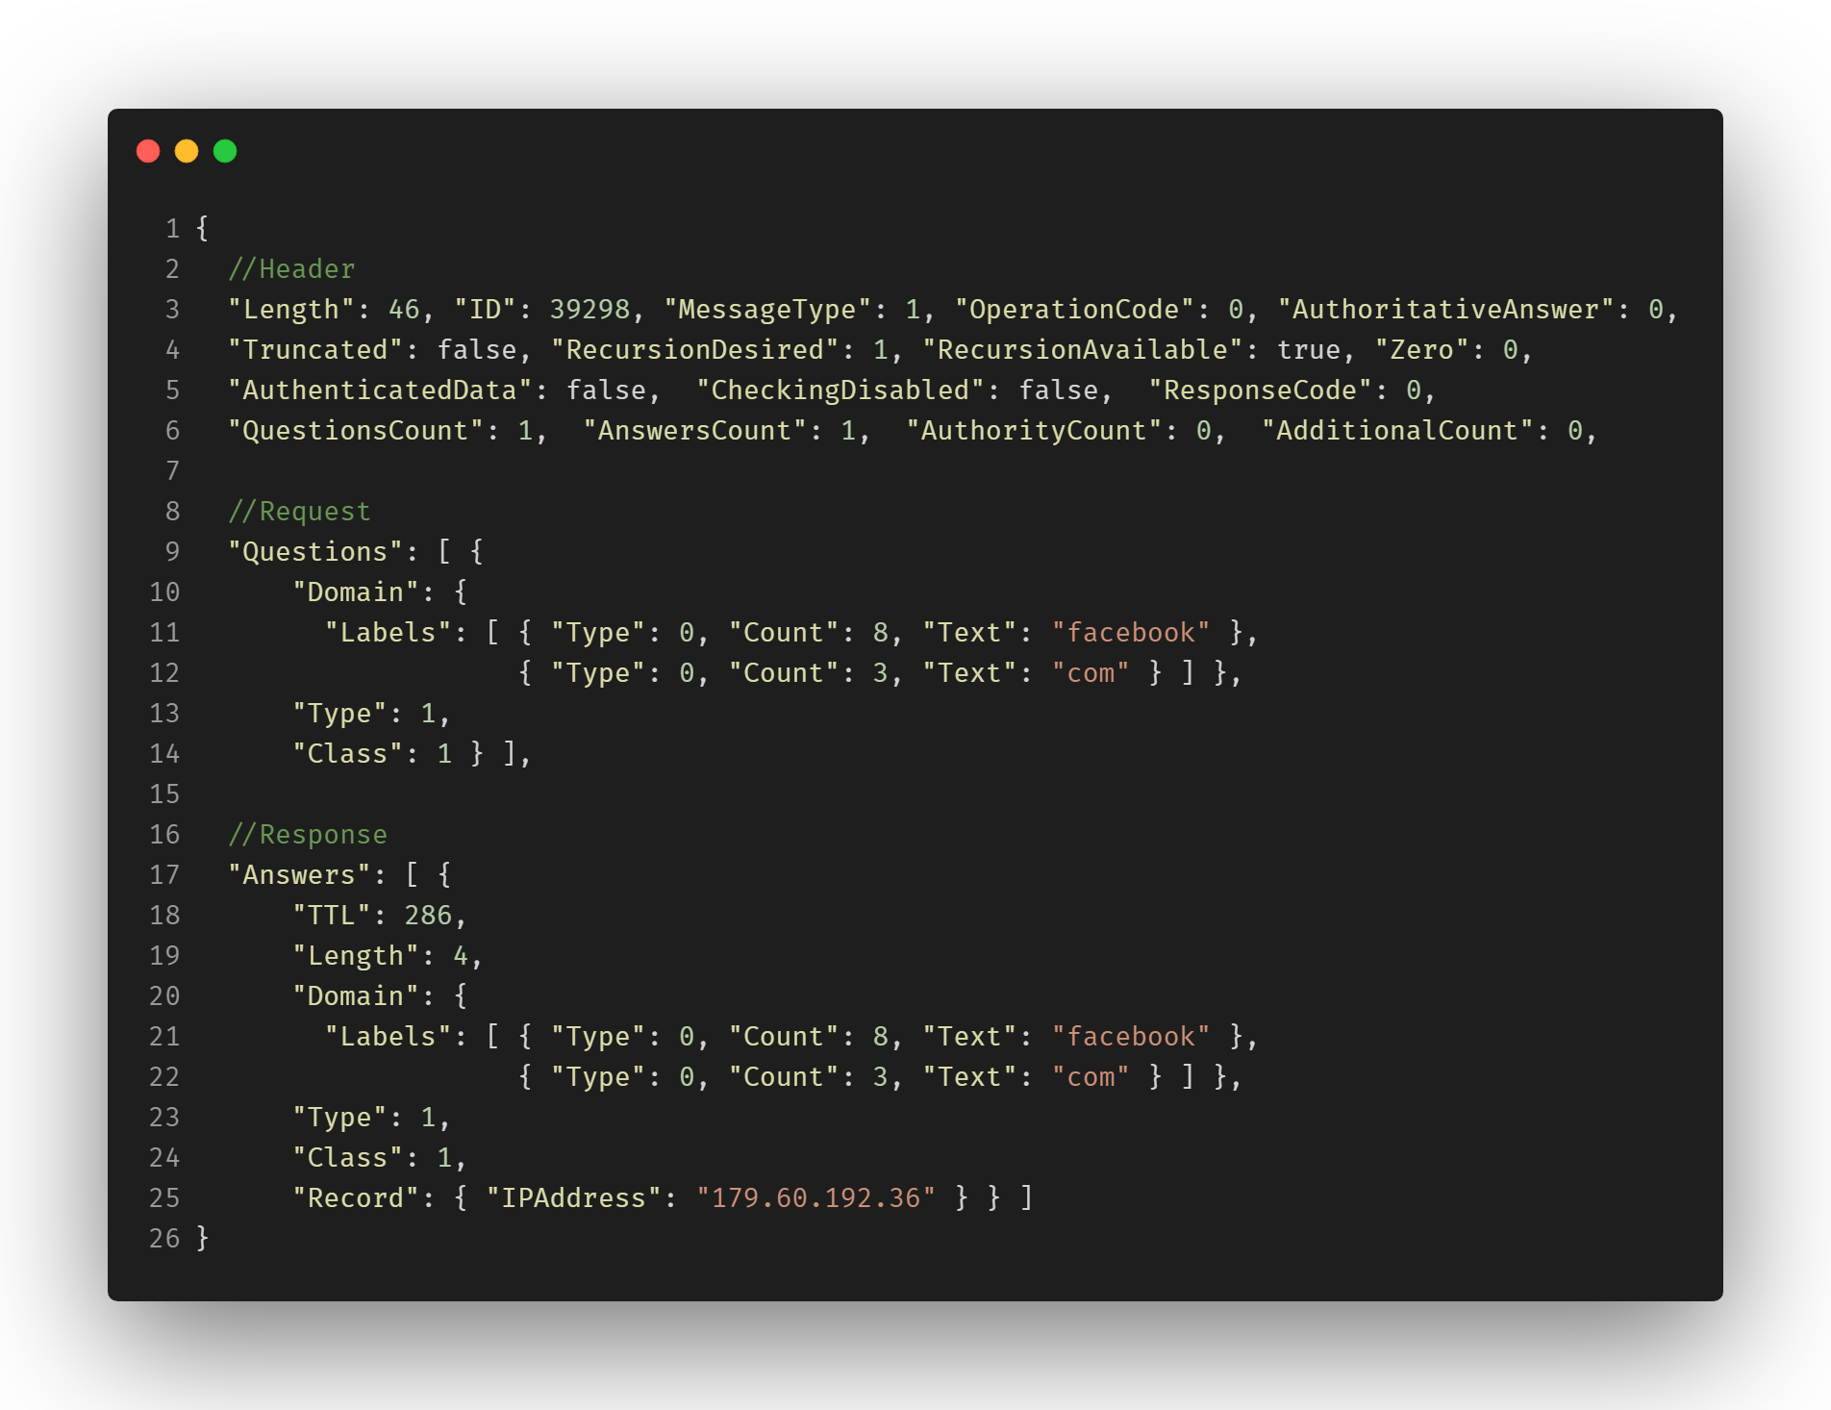
DNS: Protocol Deep-Dive
Binary Wire Format
Texnomic © 2019

Slide 35
Agenda
It’s Always DNS
DNS: The “Accurate” Definition
DNS: A 1980s Protocol in a 2020 Cyberwar
DNS: Protocol Deep-Dive
DNS Attacks in Wildlife
Standardized Cross-Platform “Lack” of Security
Understanding DNS Over TLS & HTTP/S
Modernizing Codebase
Retaking Control: Sink-holing, Monitoring & Way More!
Making Your-Own DNS Root Server!
Texnomic © 2019

Slide 36
Agenda
It’s Always DNS
DNS: The “Accurate” Definition
DNS: A 1980s Protocol in a 2020 Cyberwar
DNS: Protocol Deep-Dive
DNS Attacks in Wildlife
Standardized Cross-Platform “Lack” of Security
Understanding DNS Over TLS & HTTP/S
Modernizing Codebase
Retaking Control: Sink-holing, Monitoring & Way More!
Making Your-Own DNS Root Server!
Texnomic © 2019

Slide 37



DNS Attacks in Wildlife
Internet (External) Attacks
Flooding
Hijacking
DRDoS
Texnomic © 2019

Slide 38



DNS Attacks in Wildlife
Intranet (Internal) Attacks
Tunneling
Poisoning
Phantom
Texnomic © 2019

Slide 39
Agenda
It’s Always DNS
DNS: The “Accurate” Definition
DNS: A 1980s Protocol in a 2020 Cyberwar
DNS: Protocol Deep-Dive
DNS Attacks in Wildlife
Standardized Cross-Platform “Lack” of Security
Understanding DNS Over TLS & HTTP/S
Modernizing Codebase
Retaking Control: Sink-holing, Monitoring & Way More!
Making Your-Own DNS Root Server!
Texnomic © 2019

Slide 40
Agenda
It’s Always DNS
DNS: The “Accurate” Definition
DNS: A 1980s Protocol in a 2020 Cyberwar
DNS: Protocol Deep-Dive
DNS Attacks in Wildlife
Standardized Cross-Platform “Lack” of Security
Understanding DNS Over TLS & HTTP/S
Modernizing Codebase
Retaking Control: Sink-holing, Monitoring & Way More!
Making Your-Own DNS Root Server!
Texnomic © 2019

Slide 41




Standardized Cross-Platform “Lack” of Security
Global Issue
Texnomic © 2019

Slide 42



Standardized Cross-Platform “Lack” of Security
Global Issue
Texnomic © 2019

Slide 43
Agenda
It’s Always DNS
DNS: The “Accurate” Definition
DNS: A 1980s Protocol in a 2020 Cyberwar
DNS: Protocol Deep-Dive
DNS Attacks in Wildlife
Standardized Cross-Platform “Lack” of Security
Understanding DNS Over TLS & HTTP/S
Modernizing Codebase
Retaking Control: Sink-holing, Monitoring & Way More!
Making Your-Own DNS Root Server!
Texnomic © 2019

Slide 44
Agenda
It’s Always DNS
DNS: The “Accurate” Definition
DNS: A 1980s Protocol in a 2020 Cyberwar
DNS: Protocol Deep-Dive
DNS Attacks in Wildlife
Standardized Cross-Platform “Lack” of Security
Understanding DNS Over TLS & HTTP/S
Modernizing Codebase
Retaking Control: Sink-holing, Monitoring & Way More!
Making Your-Own DNS Root Server!
Texnomic © 2019

Slide 45


Understanding DNS Over TLS & HTTP/S
TLS
+ Prefixed Message Length
Texnomic © 2019

Slide 46


Understanding DNS Over TLS & HTTP/S
HTTP/S
Texnomic © 2019

Slide 47
Cairo Security Camp
Exclusive Announcement
Texnomic © 2019

Slide 48


SecureDNS
Open-Source Project
Texnomic © 2019

Slide 49
SecureDNS
Open-Source Project
https://Texnomic.Github.io/SecureDNS/
Texnomic © 2019

Slide 50


Modernizing Codebase
Supporters
Texnomic © 2019

Slide 51
Agenda
It’s Always DNS
DNS: The “Accurate” Definition
DNS: A 1980s Protocol in a 2020 Cyberwar
DNS: Protocol Deep-Dive
DNS Attacks in Wildlife
Standardized Cross-Platform “Lack” of Security
Understanding DNS Over TLS & HTTP/S
Modernizing Codebase
Retaking Control: Sink-holing, Monitoring & Way More!
Making Your-Own DNS Root Server!
Texnomic © 2019

Slide 52




Modernizing Codebase
Programming Language
vs
Texnomic © 2019

Slide 53






Modernizing Codebase
Technology Stack
Texnomic © 2019

Slide 54





Modernizing Codebase
Implementations
UDP
TCP
Over
TLS
HTTPs
DNSCrypt
Texnomic © 2019

Slide 55
Agenda
It’s Always DNS
DNS: The “Accurate” Definition
DNS: A 1980s Protocol in a 2020 Cyberwar
DNS: Protocol Deep-Dive
DNS Attacks in Wildlife
Standardized Cross-Platform “Lack” of Security
Understanding DNS Over TLS & HTTP/S
Modernizing Codebase
Retaking Control: Sink-holing, Monitoring & Way More!
Making Your-Own DNS Root Server!
Texnomic © 2019

Slide 56
Agenda
It’s Always DNS
DNS: The “Accurate” Definition
DNS: A 1980s Protocol in a 2020 Cyberwar
DNS: Protocol Deep-Dive
DNS Attacks in Wildlife
Standardized Cross-Platform “Lack” of Security
Understanding DNS Over TLS & HTTP/S
Modernizing Codebase
Retaking Control: Sink-holing, Monitoring & Way More!
Making Your-Own DNS Root Server!
Texnomic © 2019

Slide 57
Retaking Control
All-In-One Solutions
Self-Contained
Sinkholing
Monitoring
Blacklisting
Whitelisting
Ad-Blocking
Logging
Archiving
Auditing
Masterfile
Caching
Statistics
Reporting
Integrations
Management
RESTful-APIs
Client
Server
Agent
Root
Authoritative
Proxy
Automation
Cross-Platform
Pipelines
And more!
Texnomic © 2019

Slide 58
Retaking Control
Uniqueness
Self-Contained
Sinkholing
Monitoring
Blacklisting
Whitelisting
Ad-Blocking
Logging
Archiving
Auditing
Masterfile
Caching
Statistics
Reporting
Integrations
Management
RESTful-APIs
Client
Server
Agent
Root
Authoritative
Proxy
Automation
Cross-Platform
Pipelines
And more!
Texnomic © 2019

Slide 59





Texnomic © 2019

Slide 60

One more thing!
Texnomic © 2019

Slide 61



Groundbreaking Solution
Announcement
Over
Texnomic © 2019

Slide 62
Groundbreaking Solution
Announcement
Over
v2.0
Texnomic © 2019

Slide 63

Groundbreaking Solution
Wallet Addresses
Texnomic.Eth
0xfe171b1c5c5584b65ec58a6fa2009f6ecee812d7
Texnomic © 2019

Slide 64

Demo
Texnomic © 2019

Slide 65

Groundbreaking Solution
Starting with Texnomic.Eth
+
DNS Resolver
SMART CONTRACT
Texnomic © 2019

Slide 66
Demo
Texnomic © 2019

Slide 67

A-Call
for
Investors
Mohamed Samy
Principal Security Researcher
Texnomic Ltd.
Texnomic © 2019

Slide 68
Thank
you
Cairo Security Camp 2019
Mohamed Samy
Principal Security Researcher
@Texnomic
Texnomic © 2019

